Slide 1
Challenges Motivating Deep Learning
김문기, 노윤지

Slide 2
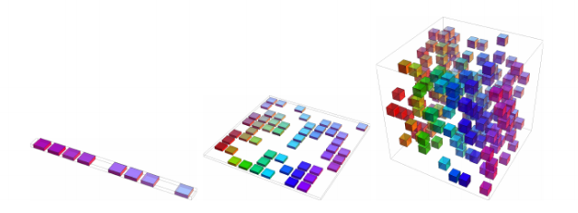
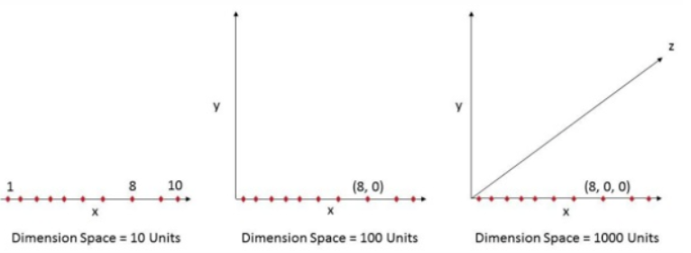
Curse of Dimensionlity

Slide 3
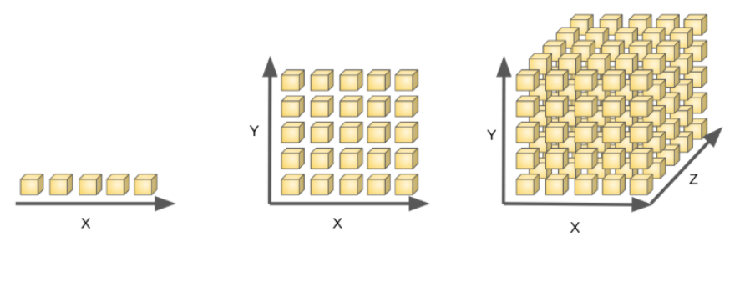
Curse of Dimensionlity

Slide 4
Curse of Dimensionlity
차원의 저주 피하기
차원을 줄이는 알고리즘
- PCA(Principal Component Analysis)
- LAD(Linear Discriminant Analysis)
- LLE(Locally Linear Embedding)
- MDS(Multidimensional Scaling)

Slide 5
Local Constancy, Smoothness Regularization
In order to generalize well, machine learning algorithms need to be guided by prior beliefs about what kind of function they should learn.
학습하는 함수들의 prior belief에 의해 특성이 달라진다.
- smoothness
- local constancy

Slide 6
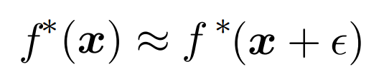
Local Constancy, Smoothness Regularization
- k-NN
- Decision Tree

Slide 7
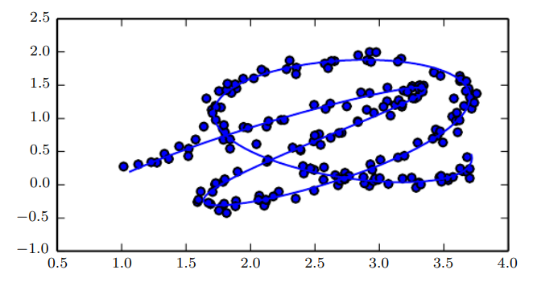
Manifold

Slide 8
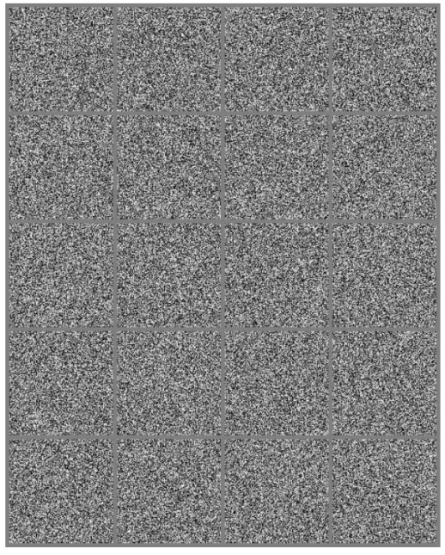
Manifold

